Slide 1
NETWORK PROGRAMMING · UTM
Shared state,
races and locks
Lecture #2 · Ernest Bîtca
Notes:
Lecture 2 of 3. Last time was about speed. This one is about correctness.

Slide 2
"Threads discard the most essential and appealing properties of sequential computation: understandability, predictability, and determinism."
Edward A. Lee · The Problem with Threads · 2006
Notes:
Edward A. Lee, 'The Problem with Threads', 2006. Read it aloud, slowly.

Slide 3
RECAP
Where we left off
LECTURE 1 RECAP
Threads share the heap.
The OS can stop a thread between any two instructions.
Five threads printed in five different orders.
What if those threads did not just print, but all incremented the same variable?
Lecture 1 was about speed. This one is about correctness — and a program can be fast and wrong.
Network Programming · Lecture 2
Notes:
Recap the cliffhanger from lecture 1 and pay it off immediately.

Slide 4
AGENDA
What we'll cover
00
01
02
03
The thread pool
The race
The ladder of fixes
Deadlock
a loose end
and why tests miss it
four steps
livelock, starvation, coordination
Network Programming · Lecture 2
Notes:
Four blocks. Block 0 is a loose end; the lecture really starts at 01.

Slide 5
00
The thread pool
One loose end from last time — then the real subject
Notes:
Ten minutes. Say explicitly that this is unfinished business from lecture 1.

Slide 6
C#
Submitting work, not threads
// lecture 1: you own the thread, you pay for it
Thread t = new Thread(Work);
t.Start();
// now: you own the work, the runtime owns the threads
ThreadPool.QueueUserWorkItem(_ => Work());
// the modern spelling of the same thing
Task.Run(() => Work());
Task.Run does not create a thread. It borrows one from the pool.
Network Programming · Lecture 2
Notes:
Flag Task.Run here — students will meet it constantly in lecture 3.

Slide 7
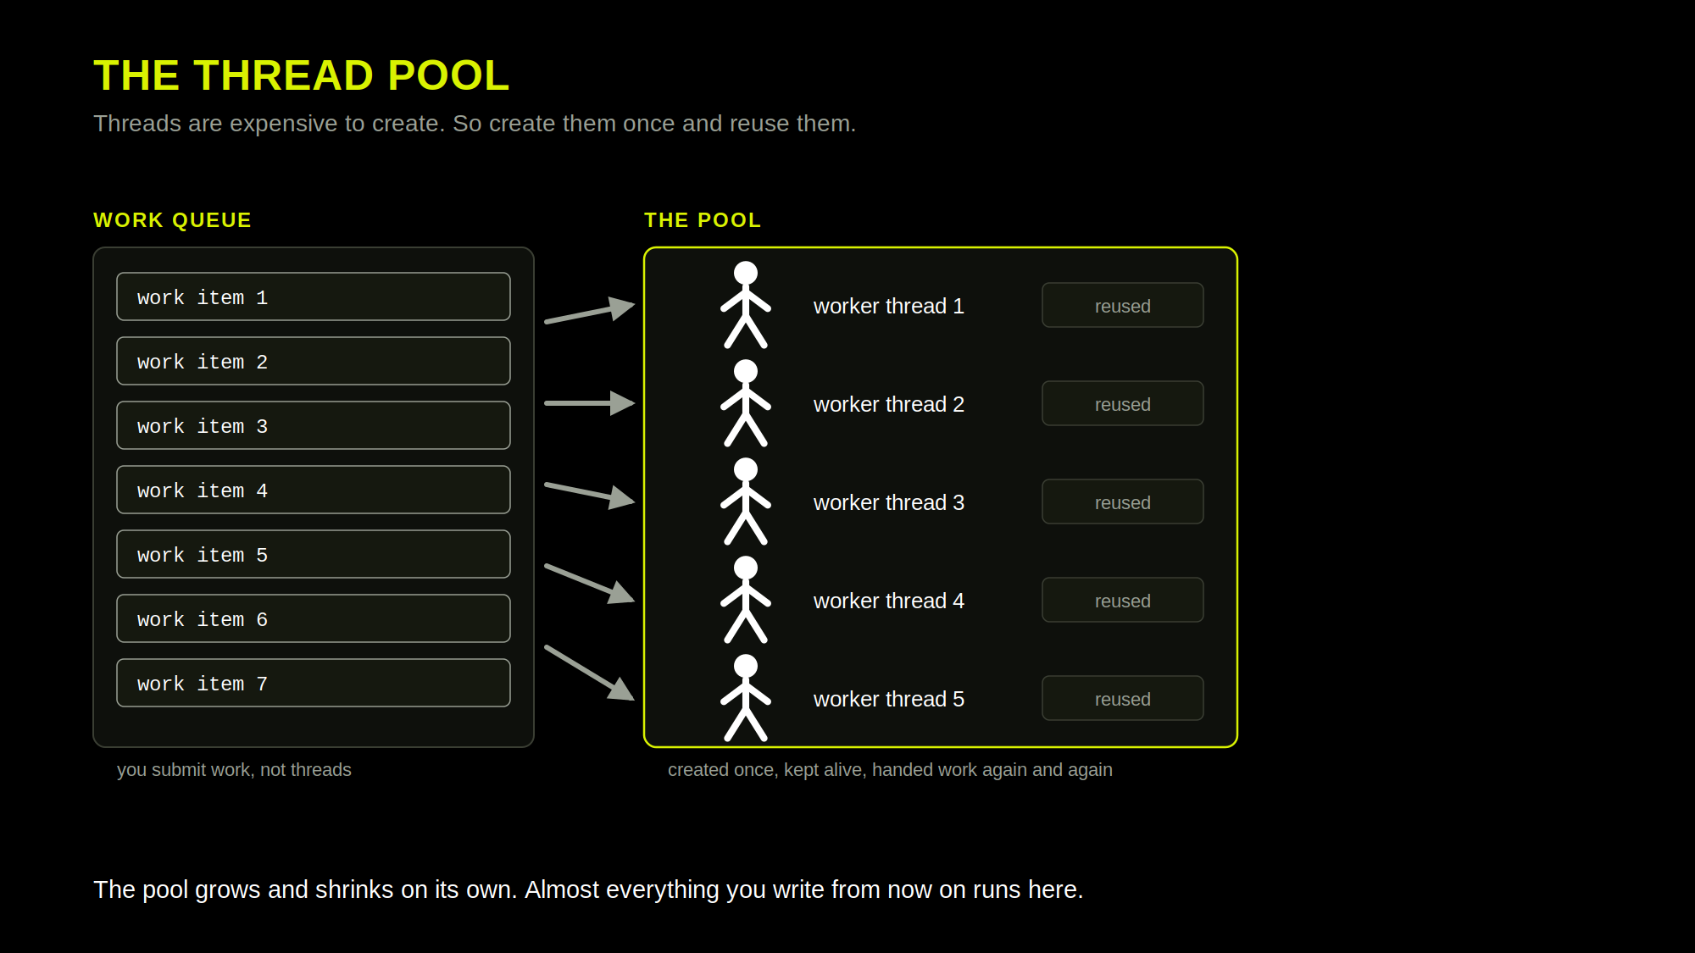
Notes:
The answer to 'threads cost 1 MB each'. Point at the queue: you submit WORK, not threads.

Slide 8
THE ONE RULE
Never block a pool thread
WHAT HAPPENS
WHY IT MATTERS HERE
The pool has a limited number of threads.
You block one waiting for something slow.
It cannot serve anyone else while it waits.
Block enough and the whole application stops responding.
This is not a performance problem — the program is CORRECT and still unusable.
The pool is designed for easy and short tasks.
Network Programming · Lecture 2
Notes:
This is the correctness angle: a starved pool is a liveness bug, not a speed problem.

Slide 9
01
The race
The question from last lecture, answered
Notes:
Run the demo BEFORE explaining anything. Let them see it fail.

Slide 10
C# — RUN IT LIVE
Eight threads, one counter
int counter = 0;
Thread[] threads = new Thread[8];
for (int i = 0; i < 8; i++)
{
threads[i] = new Thread(() =>
{
for (int k = 0; k < 1_000_000; k++)
counter++; // three operations, not one
});
threads[i].Start();
}
foreach (Thread t in threads) t.Join();
Console.WriteLine(counter); // expected: 8 000 000
Network Programming · Lecture 2
Notes:
Ask: is it too high, too low, or random? It is always TOO LOW - increments are lost, never invented.

Slide 11
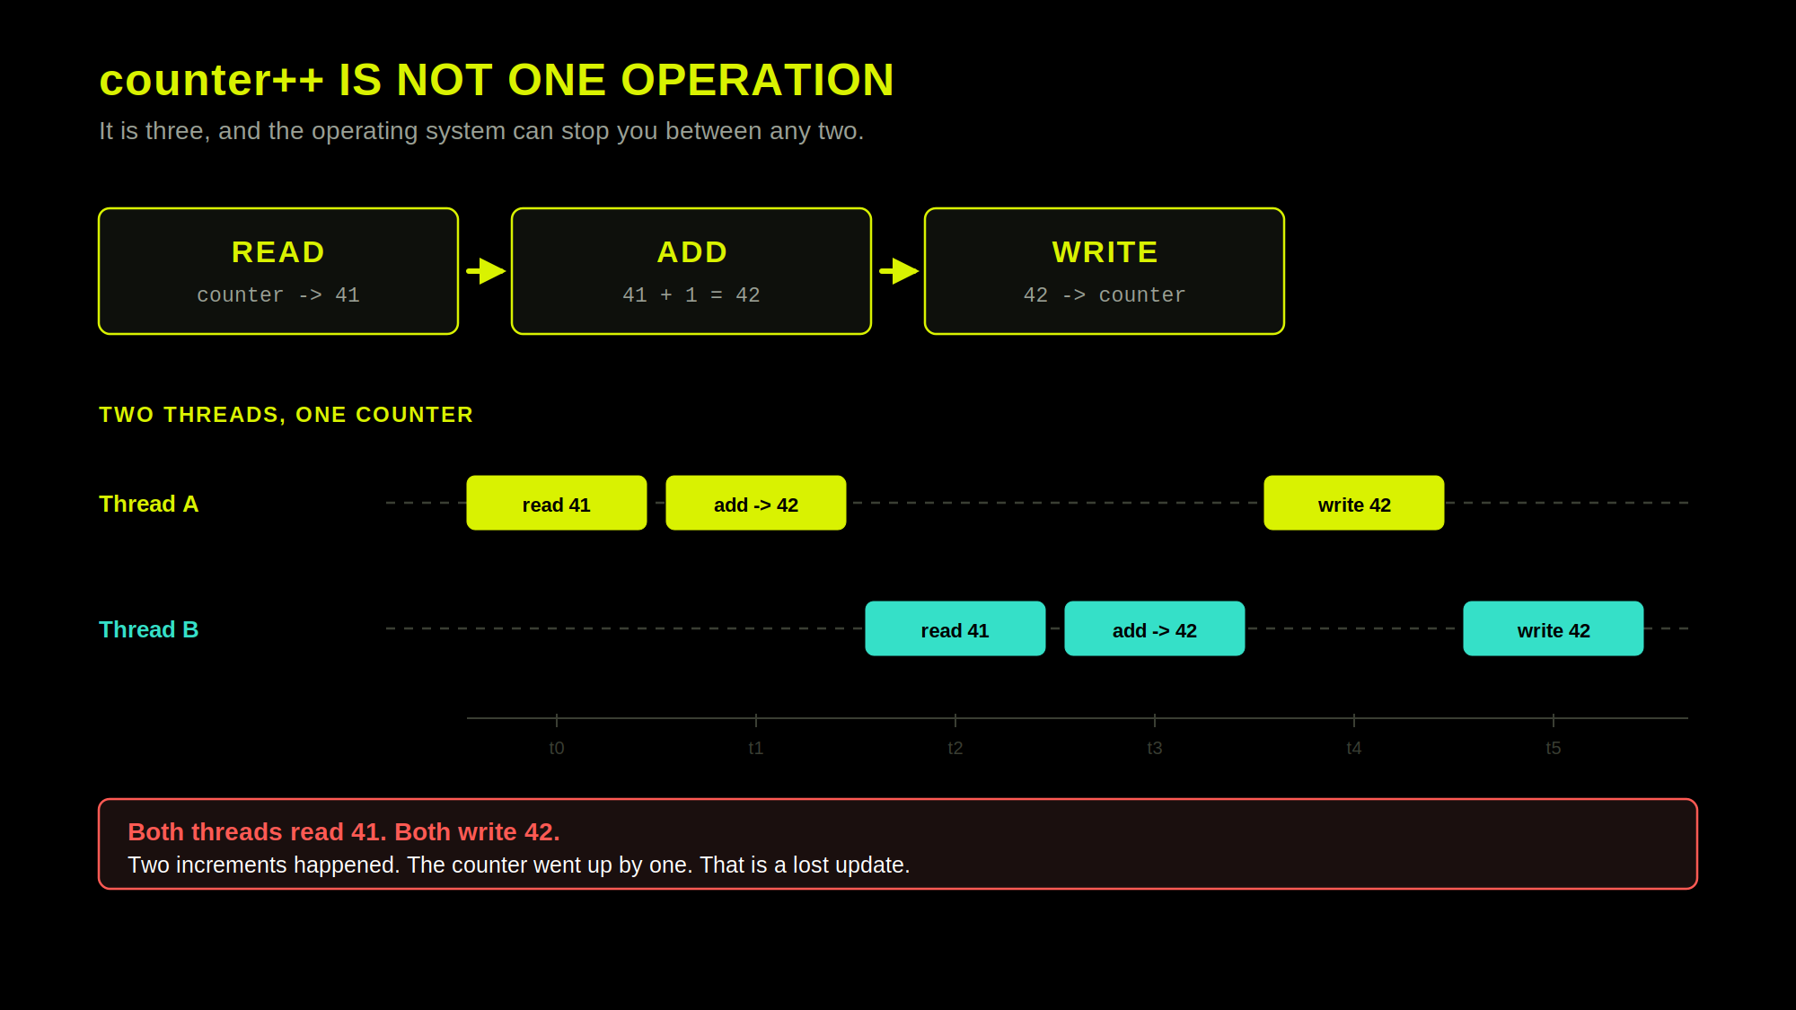
Notes:
Now explain. Three machine operations, and the interleaving that loses an update.

Slide 12
DEFINITION
Race condition
A race condition is when the correctness of a program depends on the timing of threads that nobody controls.
It needs two things: shared mutable state, and more than one thread reaching it.
Remove either one and the race is impossible — that is the whole of today's ladder.
The result is not random. It is worse than random: it is usually right.
Network Programming · Lecture 2
Notes:
Definition slide. Keep it short - they have already seen it happen.

Slide 13
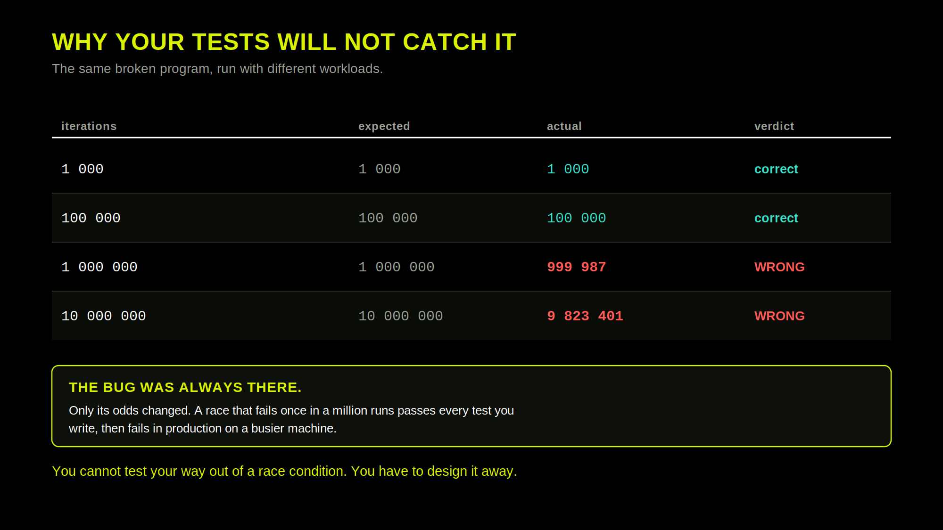
Notes:
The most important slide in the lecture. A race that fails one time in a million passes every test.

Slide 14
02
The ladder of fixes
Notes:
This is the spine of the lecture. Keep referring back to the rung numbers.

Slide 15
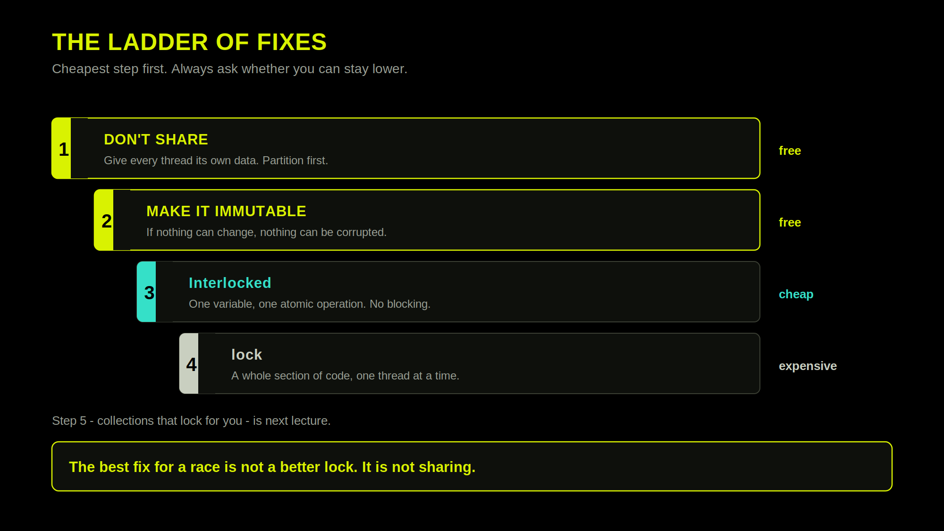
Notes:
Show the whole ladder before any code, so every fix that follows has a place to sit.

Slide 16
STEP 1
Don't share
// one slot per thread - nobody writes where anybody else writes
int[] counts = new int[threadCount];
for (int i = 0; i < threadCount; i++)
{
int index = i;
threads[i] = new Thread(() => counts[index] = Count(...));
}
int total = counts.Sum(); // safe only after Join
Network Programming · Lecture 2
Notes:
Call back to Ex08 explicitly. They have used rung 1 without knowing it had a name.

Slide 17
STEP 2
Make it immutable
class Reading // nothing here can change
{
public string Sensor { get; } // no setter
public double Value { get; } // no setter
public Reading(string sensor, double value)
{
Sensor = sensor;
Value = value;
}
}
// set once in the constructor, frozen afterwards - any
// number of threads may read it at the same time.
Network Programming · Lecture 2
Notes:
Mention that this is why functional languages have an easier time with concurrency.

Slide 18
STEP 3
Interlocked — one variable, atomically
// the hardware does read-modify-write as ONE step
Interlocked.Increment(ref counter);
Interlocked.Add(ref total, 42);
Interlocked.Exchange(ref flag, 1);
Network Programming · Lecture 2
Notes:
CompareExchange is the atom everything else is built from. Worth one minute.

Slide 19
STEP 4
lock — a whole section of code
private readonly object _gate = new();
lock (_gate)
{
// one thread in here at a time. Everyone else waits.
balance -= amount;
history.Add(transaction);
}
// two operations that must happen together -
// Interlocked cannot do this
Network Programming · Lecture 2
Notes:
This is the honest answer to 'why not just always use Interlocked'.

Slide 20
STEP 4
Four rules for lock
1. Lock on a private, readonly object.
Never lock(this) and never lock a string — anyone else can lock it too.
2. Hold it for as short a time as possible.
The lock is a queue. Everything inside it is single-threaded again.
3. Never do I/O inside a lock.
You are holding a queue open across a network round trip.
4. Every access must take the same lock.
One unguarded write makes all the other locks pointless.
Network Programming · Lecture 2
Notes:
The rules slide. Short, memorable, and every one of them is a real bug they will meet.

Slide 21
03
When locking goes wrong
Deadlock, livelock, starvation, and the primitives that are not locks
Notes:
Run the deadlock demo live. Then show the thread list in the debugger.

Slide 22
C# — RUN IT LIVE
Two locks, opposite order
// thread A
lock (first)
{
Thread.Sleep(50);
lock (second) { ... } // never gets here
}
// thread B
lock (second)
{
Thread.Sleep(50);
lock (first) { ... } // never gets here
}
Network Programming · Lecture 2
Notes:
Let it hang. Then open the debugger's Threads window and show both stuck on Monitor.Enter.

Slide 23
LIVELOCK
Each thread gives way when the other lock is busy - at the same moment, every time
SAME RESULT, DIFFERENT LOOK
deadlock
both threads wait for each other - CPU idle
no progress
livelock
both threads keep working - CPU busy
no progress
Notes:
Livelock: the threads are not blocked. They keep reacting to each other, and none of them gets anywhere - like two people in a corridor who both step aside to the same side, again and again. The example: the deadlock from the previous slide, 'fixed' by being polite - if the second lock is busy, give back the first one and try again. Both threads give way at the same moment, every time. The strip: the same result as a deadlock - no progress - but the CPU is busy the whole time.

Slide 24
LIVELOCK — RUN IT LIVE
Two locks, polite threads
static readonly Lock lockA = new(), lockB = new();
while (true) // thread 1: A, then B (thread 2: B, then A)
{
lock (lockA)
{
Thread.Sleep(50);
if (lockB.TryEnter()) // B free? take it, do not wait
{
try { Console.WriteLine("T1 got A and B, doing work!"); return; }
finally { lockB.Exit(); }
}
Thread.Sleep(50); // B busy: undo the work done with A
} // A released here
Thread.Sleep(50);
}
Network Programming · Lecture 2
Notes:
Module 2, Ex14a. lockA and lockB are of type Lock (.NET 9+): lock (lockA) works with it as with any object, and lockB.TryEnter() takes the lock only if it is free - it never waits, so there is no deadlock. Each thread takes its own lock, works 50 ms, tries the other lock, finds it busy, undoes its work (50 ms, still holding its lock), lets go and tries again. Both are in step, so every attempt fails: busy forever, done never. Stop it yourself. The undo pause matters: without it, the two threads drift apart after a few attempts and finish by luck. Ex14b waits a random 0-500 ms instead of 50 ms before trying again: soon one thread tries while the other is waiting, gets both locks and finishes, then the other one does. Ethernet does the same after a collision.

Slide 25
LIVELOCK — STEP BY STEP
Why it never ends
Time | Thread 1 (T1) | Thread 2 (T2)
0 ms | takes A (holds A) | takes B (holds B)
0-50 | sleeping... | sleeping...
50 ms | tries B → × busy (T2) | tries A → × busy (T1)
50-100 | undoing... (still holds A) | undoing... (still holds B)
100 ms | releases A (holds nothing) | releases B (holds nothing)
100-150 | sleeping... | sleeping...
150 ms | takes A | takes B
 | ... the same thing again, forever ...
Both threads always try at the same moment - so both always find the other lock busy.
Network Programming · Lecture 2
Notes:
Walk through it one row at a time. At 50 ms both threads try the other lock while it is still held, and both fail. Both undo their work and let go at 100 ms, wait 50 ms, and take their own lock again at 150 ms - exactly where they started, 150 ms later. Nothing in the code ever breaks the tie. The undo step matters: if a thread let go right after its failed attempt, the other thread - always a fraction of a millisecond later - would find the lock free and finish. That is what happens without the undo line. Ex14b breaks the tie on purpose, with a random wait.

Slide 26
STARVATION
The program makes progress. One of its threads almost never does.
SLOW WORK INSIDE THE LOCK
greedy
1 751 turns
other
waits
waits
waits
23 turns
SLOW WORK OUTSIDE THE LOCK
greedy
1 754 turns
other
1 753 turns
holds the lock
waits for the lock - ready, but not running
lock is not a queue: when it is released, the thread that is already running usually takes it again.
Notes:
Starvation: the program as a whole makes progress, but one thread almost never does. Top: the greedy thread does its slow work while it holds the lock, and takes the lock again the moment it lets it go. The other thread is ready all the time and gets in only now and then. Bottom: the same threads, but the slow work is outside the lock - now the lock is free most of the time and both get their turns.

Slide 27
STARVATION — RUN IT LIVE
A greedy thread
GREEDY THREAD
THE OTHER THREAD
while (Running())
{
lock (gate)
{
greedyTurns++;
Thread.Sleep(1); // inside!
} // and straight back in
}
while (Running())
{
lock (gate)
{
otherTurns++;
}
Thread.Sleep(1); // outside
}
1 751 turns
23 turns
waited up to 99 ms for each
Fix (Ex15b): move the slow work out of the lock - then both threads get about 1 750 turns.
Network Programming · Lecture 2
Notes:
Module 2, Ex15a: 2 seconds, two threads, one lock. The greedy thread got about 1 750 turns, the other one about 25. It gets in at all only because .NET lets a thread that has waited about 100 ms in - many locks give no such promise. Ex15b moves the greedy thread's slow work out of the lock: both get about 1 750 turns and nobody waits. This is rule 2 for lock again: hold it as short as possible.

Slide 28
LIVENESS
Three ways to stop making progress
 | Deadlock | Livelock | Starvation
The threads | wait for each other | react to each other | one waits, the others run
CPU | idle | busy | busy
Progress | nobody | nobody | everybody but one
Typical cause | locks taken in opposite order | everybody backs off the same way | a greedy thread holds the lock
Fix | one lock order for everybody | break the tie: a random wait | short critical sections
Deadlock and livelock stop everybody. Starvation stops one thread - and the averages still look fine.
Network Programming · Lecture 2
Notes:
The three ways a concurrent program stops making progress. Deadlock and livelock stop everybody, so you notice them. Starvation stops one thread while the averages look fine - look at the slowest client, not the average one.

Slide 29
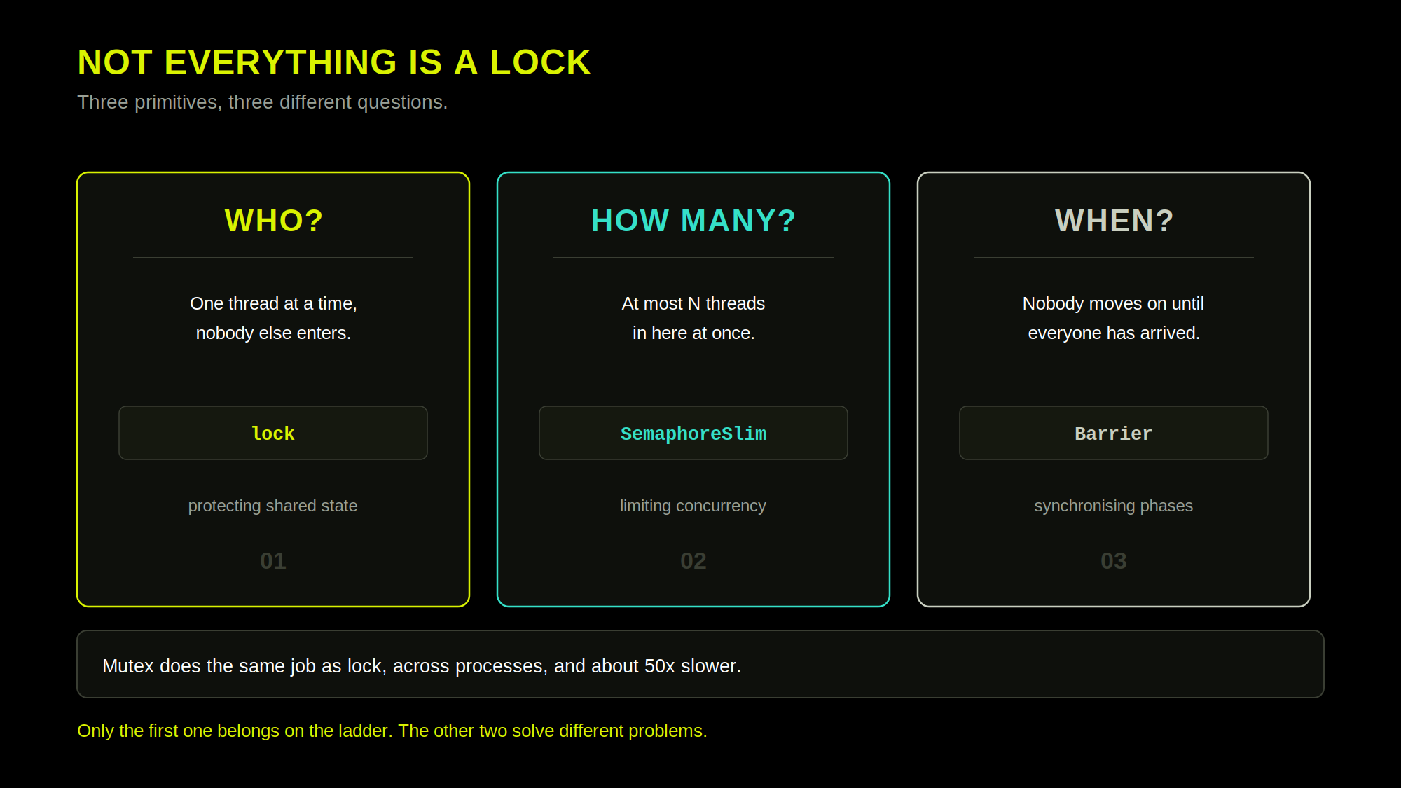
Notes:
Locks answer WHO. Semaphores answer HOW MANY. Barriers answer WHEN. Say it exactly like that.

Slide 30
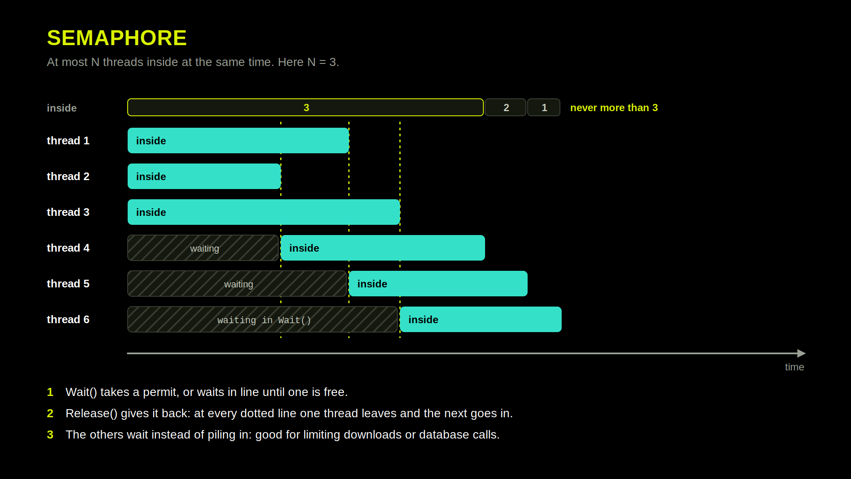
Notes:
Semaphores answer HOW MANY. Three permits, six threads: the first three go straight in, the other three wait in Wait(). Point at each dotted line: one thread calls Release(), the next one in line goes in. The count on top never passes 3. Ex10 does the same with nine workers.

Slide 31
SEMAPHORESLIM
Limiting how many, not who
// at most 3 threads inside at any moment
var gate = new SemaphoreSlim(3);
gate.Wait(); // take a ticket, or queue for one
try { DoWork(); }
finally { gate.Release(); } // ALWAYS release in finally
// this is how you cap concurrent downloads, connections,
// or database calls. You will use it in lecture 3.
A semaphore with a count of 1 behaves like a lock — which is true, and confusing. Do not start there.
Network Programming · Lecture 2
Notes:
The finally matters: an exception without Release leaks a permit permanently.

Slide 32
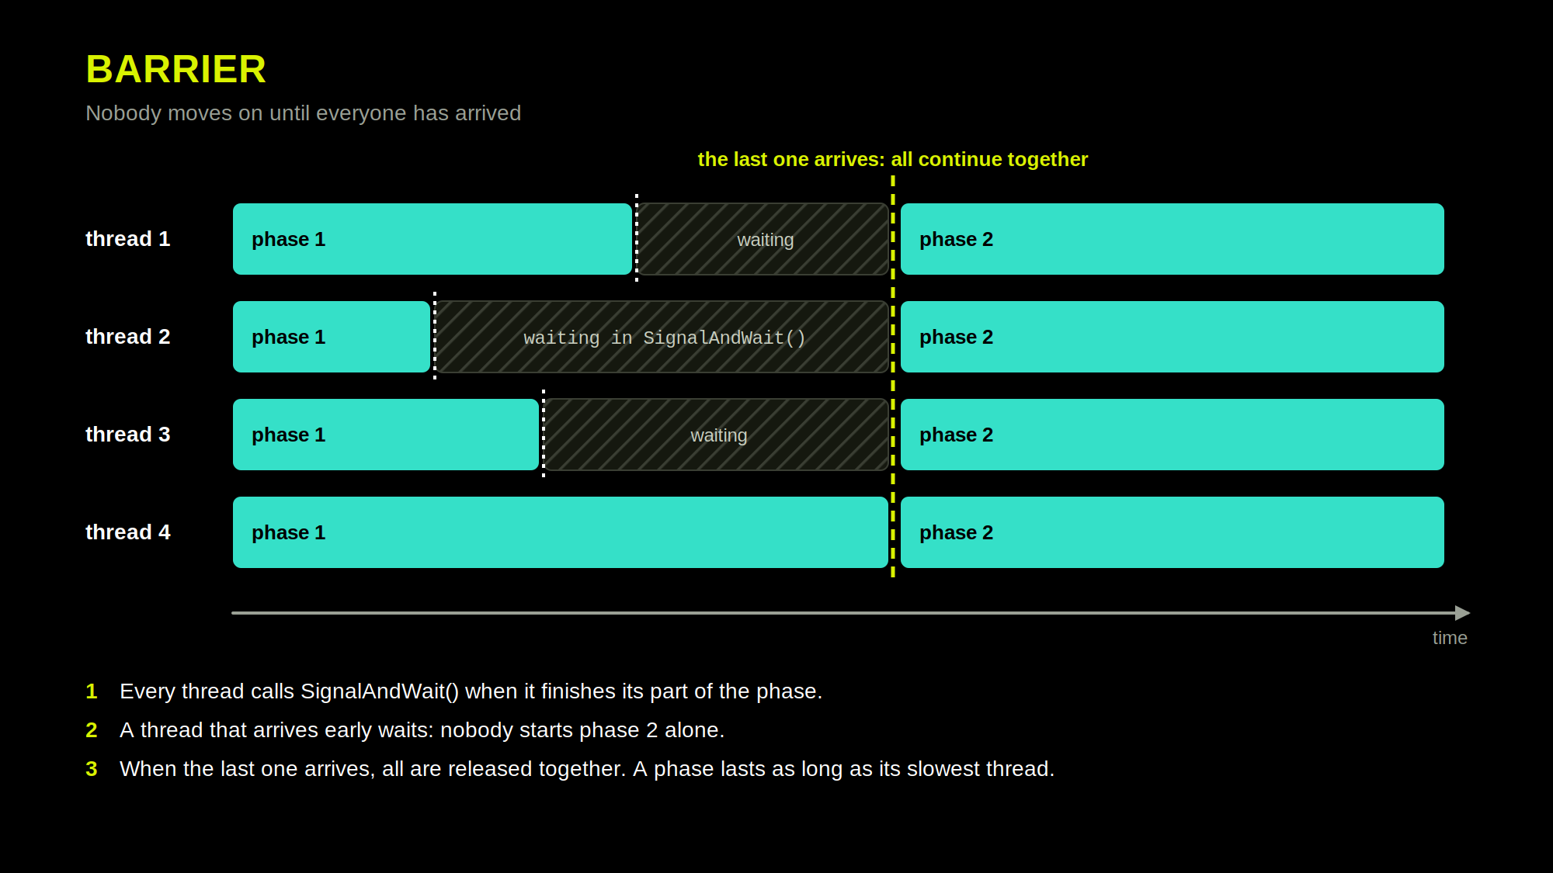
Notes:
Barriers answer WHEN. Walk one row at a time: thread 2 finishes phase 1 first and then just waits. The grey is time lost - a phase is as slow as its slowest thread. When thread 4 arrives, everybody is released at the same moment. In code: new Barrier(4), and every thread calls SignalAndWait() at the end of each phase (Ex12).

Slide 33
BARRIER
Waiting for everyone
// 4 workers; the action runs once, after all 4 have arrived
Barrier barrier = new Barrier(4, b =>
Console.WriteLine($"phase {b.CurrentPhaseNumber + 1} done"));
// every worker runs this
for (int phase = 1; phase <= 3; phase++)
{
DoWork(phase); // each worker takes a different time
barrier.SignalAndWait(); // done, wait for the other three
}
The same loop runs on every worker. Nobody starts phase 2 until all four have finished phase 1.
Network Programming · Lecture 2
Notes:
Ex12_Barrier. SignalAndWait means two things at once: 'I am done' and 'wait for the rest'. The action passed to the constructor runs once per phase, after the last worker arrives. If one worker never calls SignalAndWait, everybody waits forever - it looks exactly like a deadlock.

Slide 34
RECAP
Takeaways
01
A race needs shared mutable state plus more than one thread. Remove either one.
02
counter++ is three operations. The OS can stop you between any two.
03
You cannot test your way out of a race — the odds change, the bug does not.
04
Climb the ladder from the bottom: don't share, then immutable, then Interlocked, then lock.
05
Deadlock is a cycle. Always take locks in the same order.
Network Programming · Lecture 2
Notes:
Five statements. These are what students should copy down.

Slide 35
Thank you for your attention
Questions?
Notes:
Close.

